Slide 1
Investigation of 2 websites
Before we start. Quixel and LinkedIn

Slide 2
Why do we need that?
To create a website for MobileWorldStation, you will compare existing websites that sell mobile phones, accessories, and services. By doing so, you can gather ideas on the layout, design, and features to include on the website. This will help you create a website that is visually appealing, easy to navigate, and provides an excellent user experience for potential customers. Additionally, you can learn from the strengths and weaknesses of other websites to make your website stand out and attract more visitors.

Slide 3
Quixel.com
Quixel powers one of the world's largest photogrammetry asset library and bundled toolset: Megascans, Bridge and Mixer — forming a robust content creation ecosystem for producing high-quality 3D content.

Slide 4
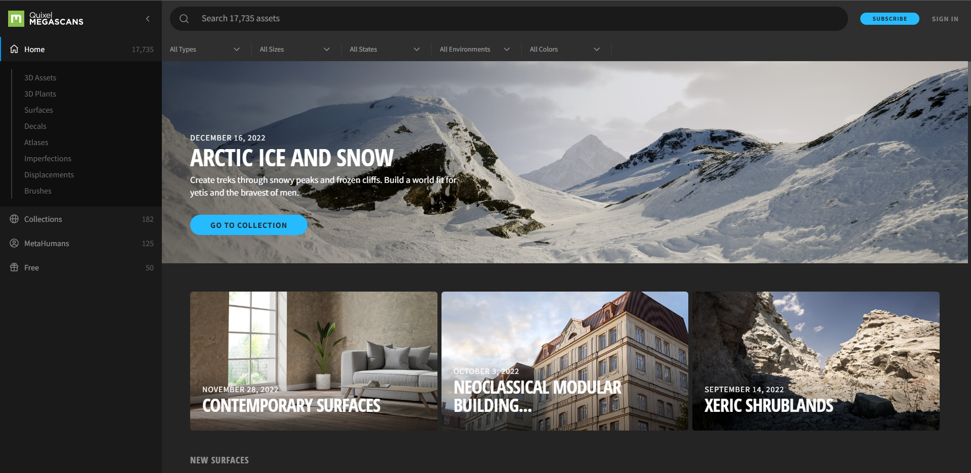
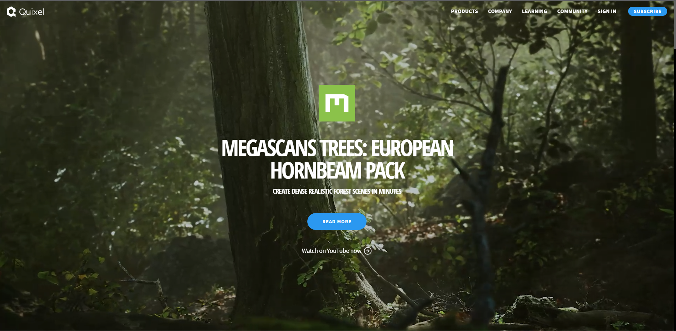
Uses of Quixel
Provides high-quality 3D assets for use in video games and other media
Offers a library of premade assets and tools for creating custom assets
Provides a platform for artists to showcase their work and connect with potential clients
Offers educational resources for artists and developers
Allows users to create and share their own 3D assets through the platform

Slide 5
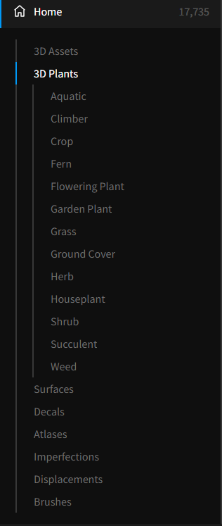
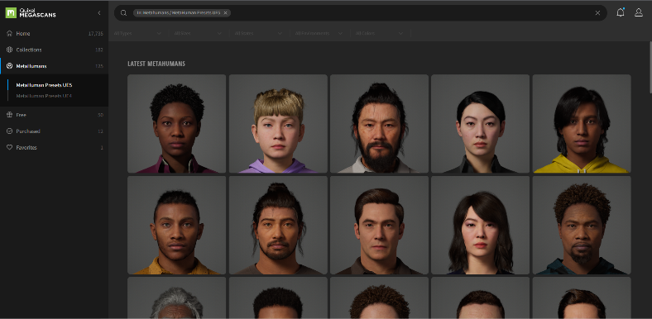
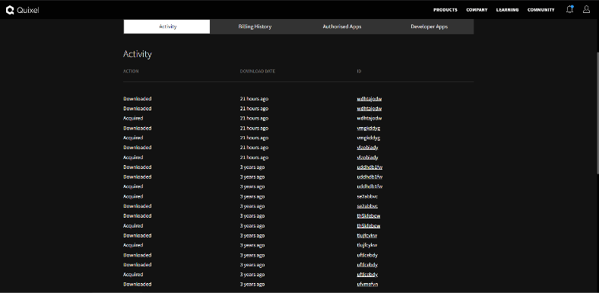
Features of Quixel
Action buttons for adding assets to a cart and viewing purchase history
Hot spots for browsing assets by category and searching for specific assets
Email links for contacting support and submitting feedback
Registration and login for creating and managing accounts
Forms for purchasing assets and providing payment information
E-commerce facilities for processing payments and managing licences
Online forums for community support and discussion
Aesthetics include a sleek and modern layout, with dark colours and high-quality graphics and text styles
Accessibility features such as screen reader compatibility and adjustable font size and colour contrast
Big collection of MetaHumans
Big amount of High-Resolution Assets, such in 8k+

Slide 6
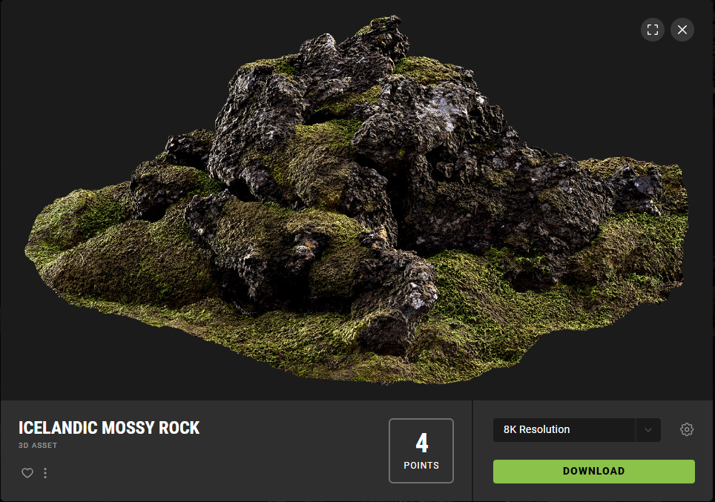
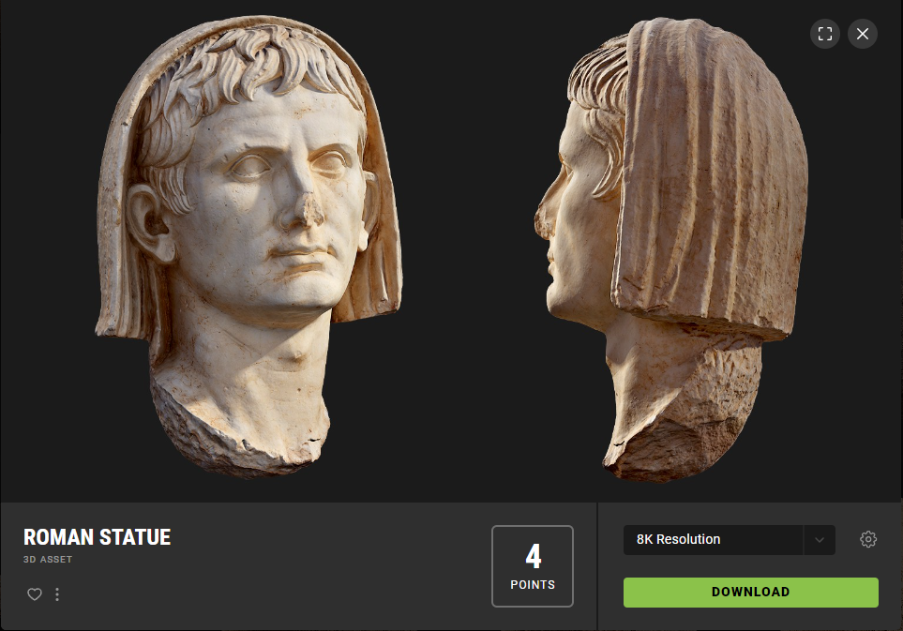
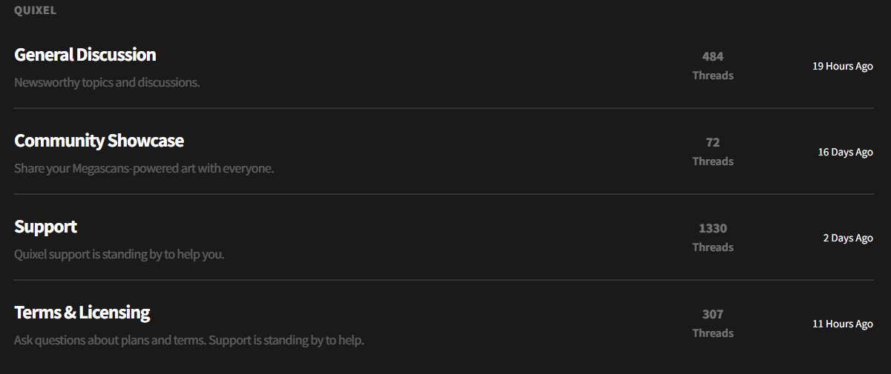
Strengths of Quixel
High-quality assets and tools for creating 3D models and textures
Strong community and support features for artists and developers
Educational resources and tutorials for learning and improving 3D art skills
Provides a platform for artists to showcase their work and connect with potential clients
- High-quality and realistic 3D assets and textures for use in video games and other media - Wide variety of pre-made assets and tools for creating custom assets, making it a one-stop-shop for 3D assets - Easy to use interface and search system for finding and downloading assets quickly - Platform for artists to showcase their work and build their portfolio, potentially leading to career opportunities or partnerships - Educational resources and tutorials for learning and improving 3D art skills - Supports multiple 3D software programs, providing flexibility for artists and developers to work with their preferred software - User-friendly website design and layout that is visually appealing and intuitive to navigate - Continuously updates and adds new assets, keeping up with industry trends and technology advancements

Slide 7
Weaknesses of Quixel
Limited audience, catering primarily to video game developers and 3D artists
Some users find the website overwhelming or difficult to navigate due to the vast number of assets available
Some users have slow loading times and technical issues when browsing or downloading assets. As servers could be overloaded.
- While Quixel provides a vast selection of high-quality assets, some users may find that the assets do not meet their specific needs or aesthetic preferences, requiring them to create their own assets or seek out other asset providers - Some users may prefer to create their own assets from scratch rather than purchasing pre-made assets - The website could benefit from more robust search and filtering options, allowing users to more easily find specific assets or categories of assets - Some users may find the website design to be outdated or not visually appealing, potentially turning them away from using the platform - The checkout process for purchasing assets could be smoother and more user-friendly, potentially leading to a better overall user experience - The website could benefit from more interactive features, such as community forums or asset review systems, to encourage user engagement and collaboration - While the website offers educational resources and tutorials, some users may find them to be limited in scope or not comprehensive enough to effectively learn new 3D art skills.

Slide 8
LinkedIn.com
LinkedIn is the most popular professional online platform for job seekers and businesses. Learn how to make the most of this valuable tool. LinkedIn is a social platform where professionals can network, search for jobs, sign up as freelancers, and publish articles.

Slide 9
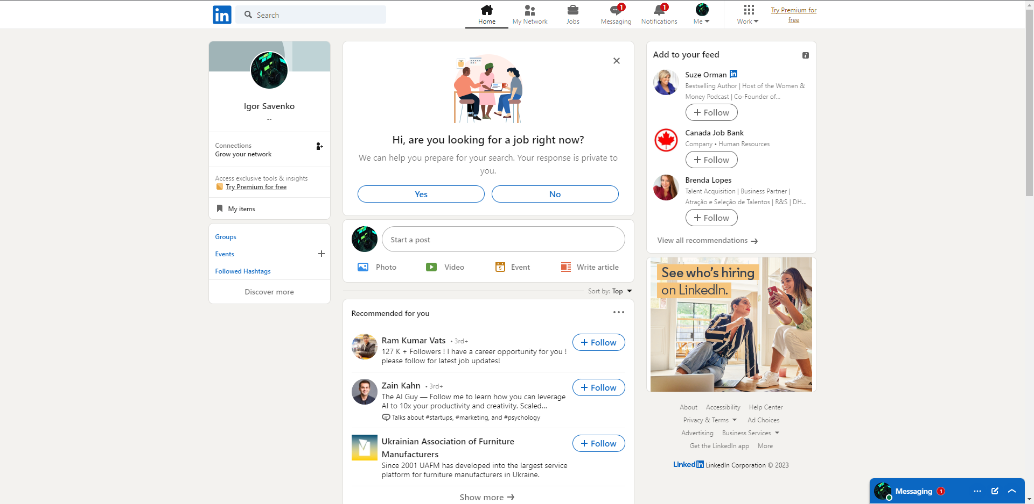
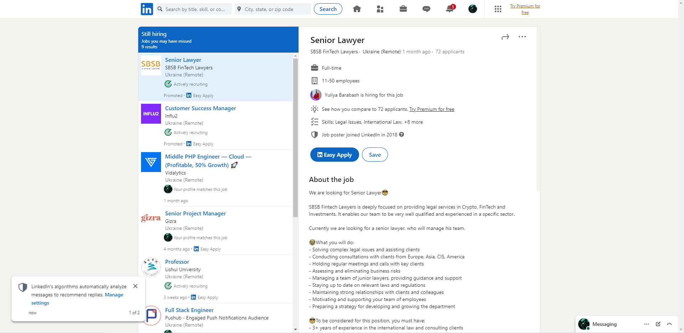
Uses of LinkedIn
Professional networking platform for connecting with colleagues and potential employers
Allows users to showcase their skills and work experience through a digital resume
Provides job search and recruitment tools for both employers and job seekers
Offers educational resources and courses for professional development
Provides a platform for publishing and sharing industry news and insights

Slide 10
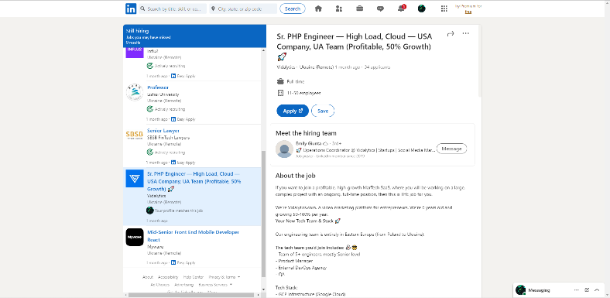
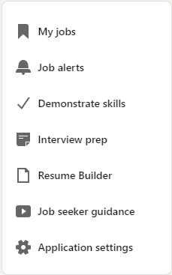
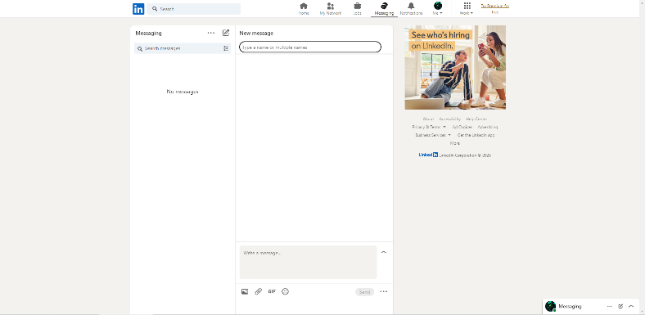
Features of LinkedIn
Action buttons for adding connections, applying for jobs, and posting updates
Hot spots for browsing job postings, industry news, and other relevant content
Email links for contacting connections and employers
Registration and login for creating and managing accounts
Forms for creating a digital resume and applying for jobs
E-commerce facilities for purchasing premium subscriptions and courses
Online forums for discussion and community building
Aesthetics include a professional and clean layout, with muted colours and simple graphics and text styles
Accessibility features such as screen reader compatibility and adjustable font size and colour contrast

Slide 11
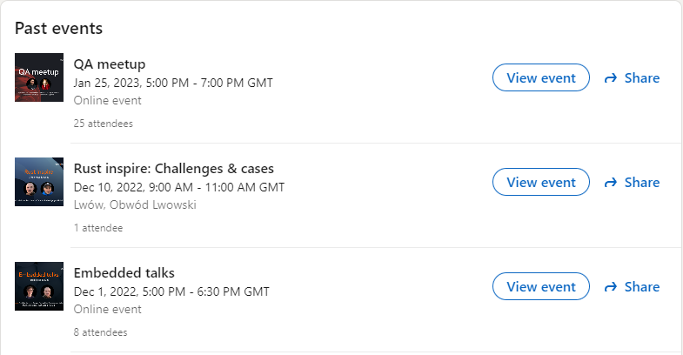
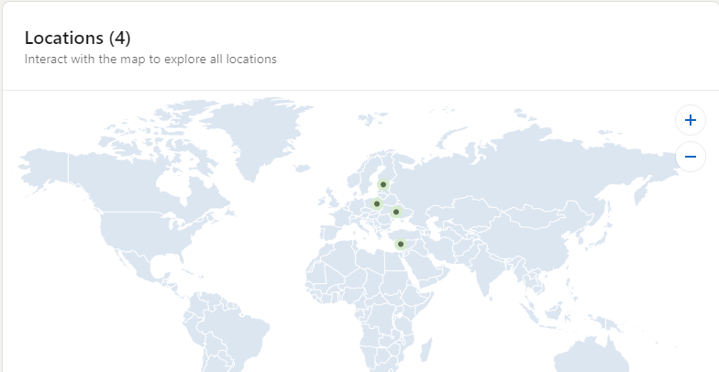
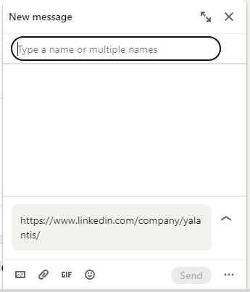
Strengths of LinkedIn
Events of Company
Location filter, check offices in other countries
Ability to chat with companies and HR’s.
Provides a mobile app for access to the platform on-the-go, enabling users to stay connected and up-to-date at all times.
Enables users to join professional groups and participate in discussions with like-minded individuals
Provides a platform for professional networking and career development Offers job search and recruitment tools for both employers and job seekers Educational resources and courses provide opportunities for continued learning and professional development Publish and share industry news and insights

Slide 12
Weaknesses of LinkedIn
Some users may find the website too focused on professional development and may prefer a more casual networking platform
The platform's algorithm for recommending posts and content to users may not always be effective, leading to irrelevant or uninteresting content in users feeds.
LinkedIn's messaging system can be confusing or difficult to navigate, leading to missed or delayed messages
- The job search and recruitment tools may not be effective for all industries or job types - Some users may not agree with LinkedIn's business practices or policies - Can be overwhelming for new users or users who are not familiar with the platform's features and etiquette - Some users may find the platform to be overly focused on professional achievements and may feel pressure to constantly update their profiles and seek out new job opportunities - The job search and recruitment features may be less effective for certain industries or job types, leading to limited job opportunities or a lack of suitable candidates - The platform may be less useful for users who are not actively seeking new job opportunities or professional connections - Some users may receive a large number of unsolicited messages or connection requests from strangers, potentially leading to spam or unwanted communication - While LinkedIn offers educational resources, these resources may be less comprehensive or less effective compared to dedicated online learning platforms

Slide 13
Conclusion
In conclusion, both websites offer unique features and strengths, catering to different purposes and audiences. While Quixel provides high-quality 3D assets and tools for video game developers and 3D artists, LinkedIn offers a platform for professional networking and career development. Understanding the intended purpose and features of each website can help improve the user experience, accessibility, and engagement for users.

